Slide 1




Sales Performance Analysis
Project 2 - Mohit Shukla

Slide 2
Problem statement :
What’s the monthly sales performance by product segment and product category to help client identifying the segments and categories that have met or exceeded their sales targets and those that have not ?

Slide 3
Solution :
To analyse the sales performance against Sales Target we provide a dashboard build with Tableau to Identify categories and segments which exceed the Target.
We will highlight the Sales above and below the target.

Slide 4
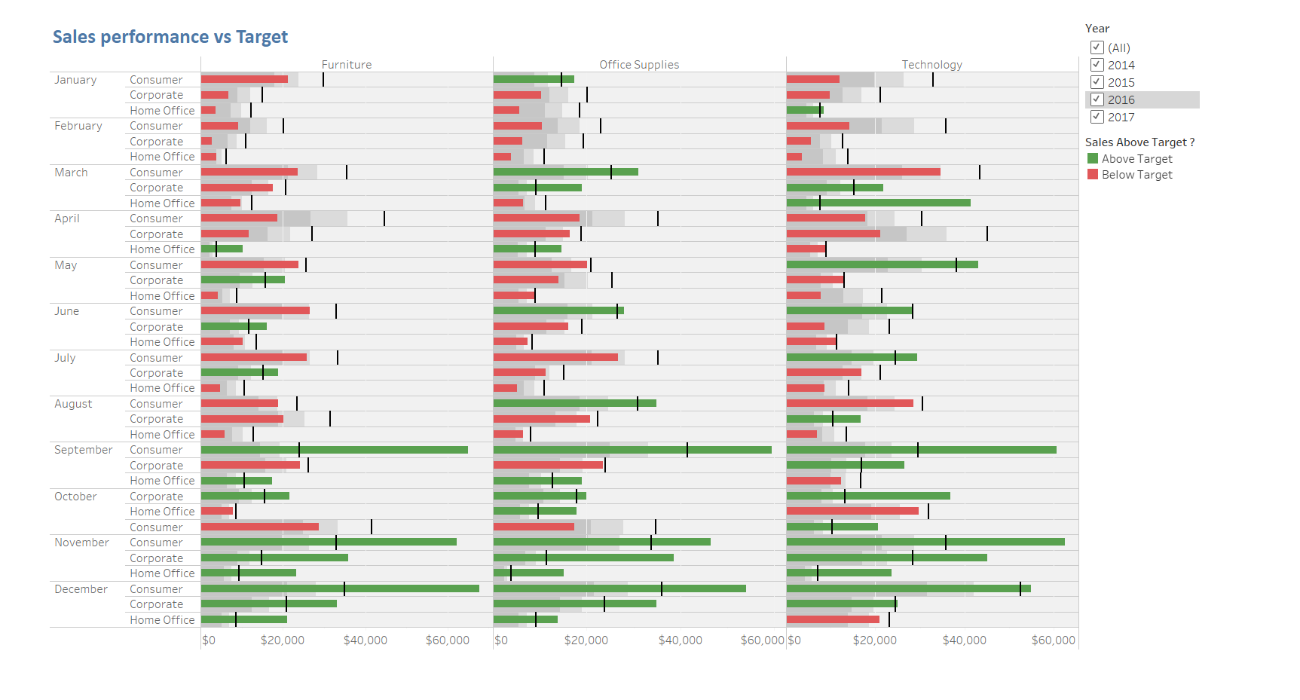

Slide 5
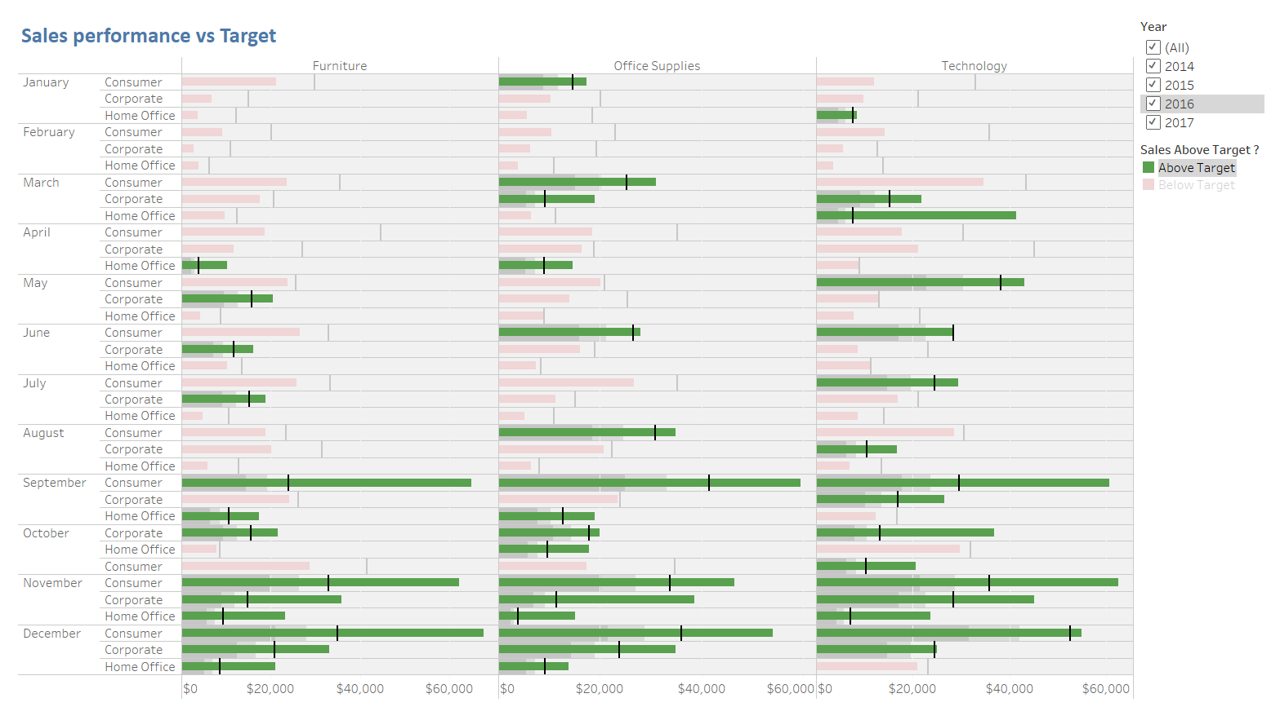
Sales Above Target Highlight
Along the years all categories exceed the target in November and December for all segment
Office Suppliers and Technology categories exceed target for segment Consumer and Corporate in March, June, September
October provide good achievement also for all the categories in some segment

Slide 6
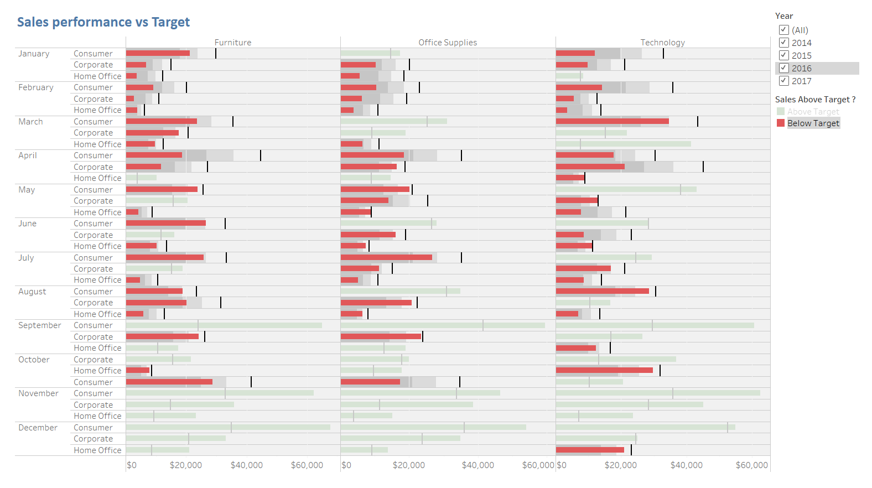
Sales Below Target Highlight
For all the categories Consumer and Corporate segment have lower sales in the first quater (January, Februry,March)
In July and August we have same performance.

Slide 7
Thanks

